Slide 1



Introduction to Svelte
Mikha Davids
https://github.com/MikhaD
Notes:
Who am I?
Going to be speaking about what svelte is for about 10 minutes
Then run through the basic features
Then if there is time, I’ll make a simple application

Slide 2
What is Svelte?
Front end Framework, similar to Vue, React, Angular
Created by Rich Harris for non Web Developers
Superset of HTML
Compiler, unlike other frameworks
Faster, smaller, more concise
Notes:
Svelte is a front-end framework. If you have ever used React, Vue, or Angular, it does the same job that those do, namely make JavaScript a little less miserable to work with.
Created by a man named Rich Harris while he worked at the Guardian, and later the New York Times for creating interactive graphics for news articles. This meant he needed it to be accessible to people in the news-room who’s primary job was not necessarily web development.
Rich Harris is now being employed by Vercel to work on Svelte full time.
Unlike React, where you are writing HTML in your JavaScript, Svelte is a superset of HTML. That means all valid HTML is valid Svelte.
The big difference with Svelte is that it is actually a compiler. All the frameworks that came before it are libraries that need to be shipped to the client, meaning there is always a JavaScript overhead, no matter how small the app is. Svelte has a compile step, where it converts your svelte files into fast, efficient vanilla JavaScript.
The result is not only faster, smaller bundles, but syntax that is far more concise.

Slide 3
Svelte vs SvelteKit
Your Svelte code runs on the user’s device
SvelteKit provides more options for full blown sites
Everything you learn here is applicable to SvelteKit
Notes:
There are two main ways to write svelte applications, Svelte and SvelteKit. We are only going to be looking at Svelte today, which is the code that is going to be running on the user’s computer.
SvelteKit is similar to Next.js is for react. It provides routing, code splitting, server side rendering etc.
If You were writing an app from the ground up that required server side code, like most things do, SvelteKit would be the way to go.
SvelteKit is an enhancement, everything you learn here will be applicable to SvelteKit too.

Slide 4
Prerequisites
Some coding experience
Ideally some JavaScript, HTML & CSS experience
A laptop
Nodejs
A development environment
Notes:
I am not going to be teaching you how to code
Preferably some experience with HTML and CSS so what I’m doing is not completely foreign to you. As I mentioned, Svelte is a superset of HTML
The idea is for you guys to code along with me. If you do not have a laptop with you that becomes quite difficult. Perhaps you can collaborate with the person next to you, if they’re feeling charitable.
Svelte and its associated packages are themselves written in JavaScript. This means that to run your application while you’re working on it you need to have Nodejs, the JavaScript runtime installed.
Finally you need a development environment. I would suggest VS Code, as it supports HTML, CSS and JavaScript out of the box and has a first party Svelte Plugin.

Slide 5
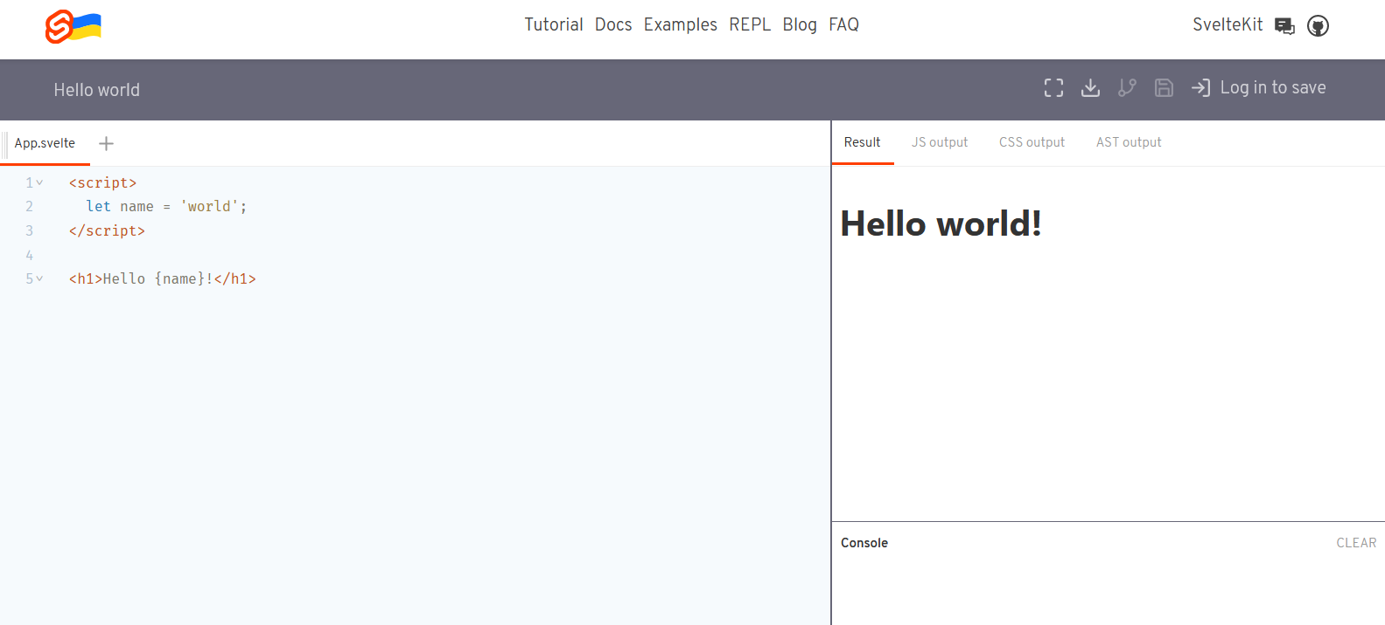
Alternative: Svelte REPL
https://svelte.dev/repl

Slide 6
Further Resources
Official Svelte Tutorial
https://svelte.dev/tutorial
Official SvelteKit Tutorial
https://learn.svelte.dev/tutorial
Notes:
If you want, you can open the tutorial and follow it while I’m speaking, what I am going to go through next is just a worse version of the official tutorial

Slide 7
Getting Started
npm init vite@latest

Slide 8
Further Resources
Official Svelte Tutorial
https://svelte.dev/tutorial
Official SvelteKit Tutorial
https://learn.svelte.dev/tutorial
Notes:
What I am going to go through next is probably just a worse version of the official tutorial, which is fantastic

Slide 9

Thank You
Follow me on GitHub
https://github.com/MikhaD

